Slide 1
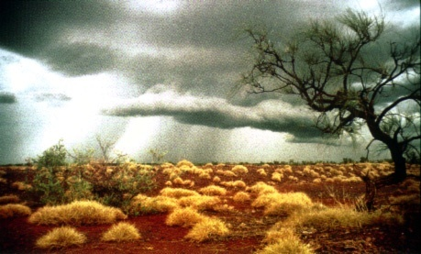
fire and the ecology and evolution of terrestrial vegetation
DARWIN TALK SERIES, NCBS
7th July 2009 Tuesday 5 pm
NCBS Lecture Hall 1
Prof. William Bond Botany Department
The University of Cape Town, South Africa
Terrestrial ecosystems have been burning for millions of years. Yet until recently, fire has not been considered as a factor driving evolution. However major revolutions in vegetation history, distinct suites of traits and alternative states of eco-systems ,may be related to fire regimes and activity. I suggest that flammable ecosystems have evolved along divergent pathways from forests resulting in discrete, ancient assemblages with distinct endemic biotas.
Vehicle leaves IISc. at 4:15 pm from the parking bay in front of the main library and at 6:30 pm from NCBS to IISc.
Tata Institute of Fundamental Research
GKVK, Bellary Road,
Bangalore 560 065
www.ncbs.res.in

